Slide 1
MATLAB for Scientists Lecture 9: Image analysis II

Slide 2
Image segmentation
Image masking
Extracting regions of interest
Calculate image properties within ROI

Slide 3
Image segmentation
Extracting and/or partitioning objects in an image into groups or categories for analysis

Slide 4
Image segmentation functions
bwboundary | Find boundary of objects in an image
drawrectangle | Define rectangular region on an image
imcrop | Crop an image given specified rectangular vertices

Slide 5
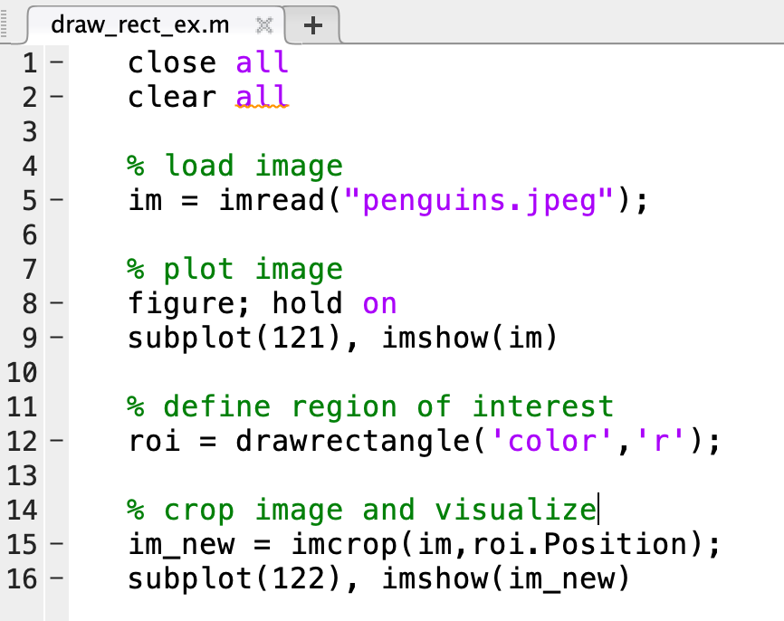
Cropping images
You can always crop images, but usually this won’t be specific enough!
roi = drawrectangle() lets you define a subset of an image to work with

Slide 6
bwboundaries for object counting
[B L N] = bwboundaries(im);
B traces the exterior boundaries of objects in im, an nxm binary image
B is a cell of size {1,N}, where N is the number of objects
B{1} = a matrix of size x,y, that traces the boundary of the first object identified in im
L is the labels for the objects

Slide 7
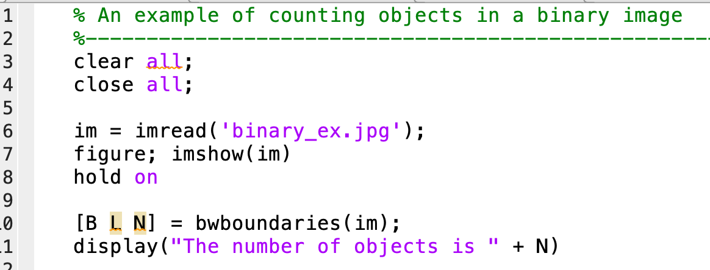

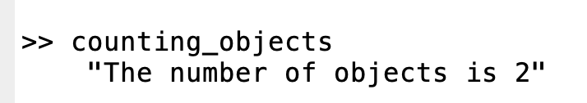
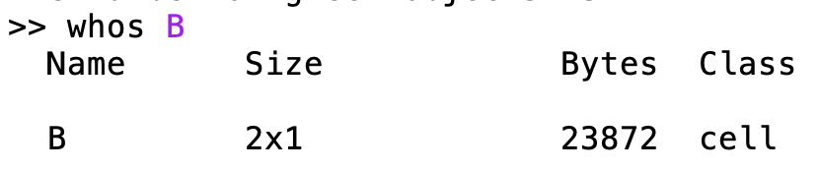
Count the number of objects in a binary image
2 objects
cell class

Slide 8
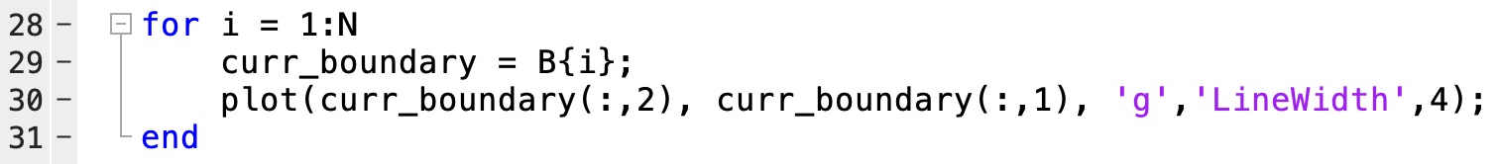
Tracing the boundaries of each object

Slide 9
Image masking
What if we don’t have a binary image to start with?
An image mask is a filter that is applied to an image to isolate a specific ‘region of interest’ (ROI) within the full image
In MATLAB, a mask is a binary (logical) matrix that is the same size as the image we are filtering, equals 1 only within the region you want to extract, and 0 everywhere else
Full image
Image mask
Masked (or filtered) image
Black → mask = 0
White → mask = 1

Slide 10
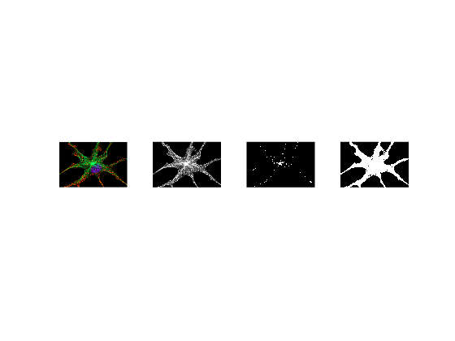
Image thresholding
Thresholding is used to create a mask of a grayscale image to hide all objects that are not of interest (if in RGB, must be converted to grayscale!)
This is done by creating a binary version of an image & setting all pixels whose intensity values are above a desired threshold level = 1,and all remaining pixels = 0
Global thresholding:
G(x,y) = 0 if f(x,y) < = Threshold
G(x,y) = 1 if f(x,y) > Threshold
Original
Grayscale
Mask with high threshold
Mask with low threshold

Slide 11
Processing functions to make an image mask
imbinarize(imgray,thresh) | Converts a grayscale image to a binary image at a user-specified threshold level Thresh is a number between 0 and 1
graythresh(imgray) | Global image thresholding using Otsu method

Slide 12
Algorithm for image thresholding and segmentation
Load the image: im=imread(‘image.png’)
Define grayscale image: convert the image into grayscale
If an RGB image with im_gray=rgb2gray(im)
Can use R, G, or B layer individually if one layer has objects of interest (e.g., stained nucleus etc.)
Define mask at specified threshold level: choose a threshold level t between 0 and 1, and convert the image into binary based on this threshold level: im_mask=imbinarize(im,t)
Analyze the objects of interest within the mask: boundary=bwboundary(im_mask)

Slide 13
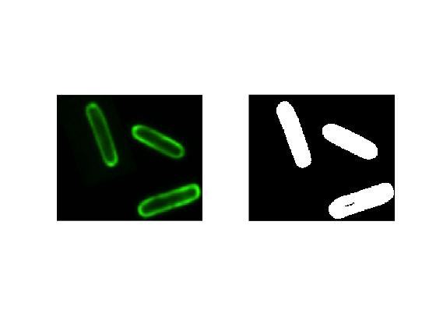
Find the number of cells in this picture:
How many objects are in this image?
Step 1: load the image

Slide 14
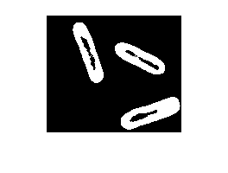
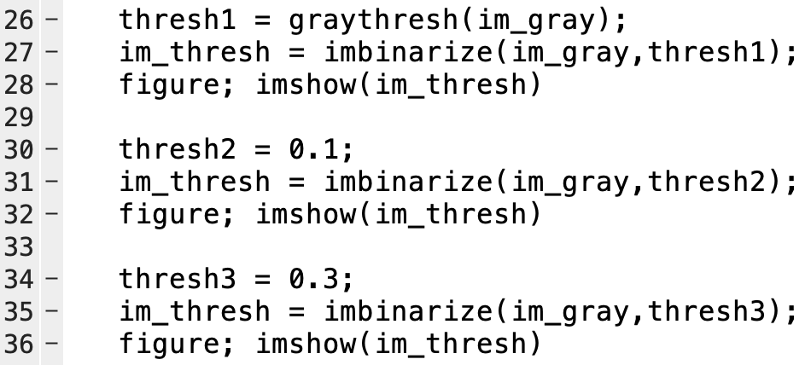
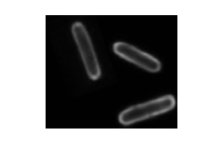
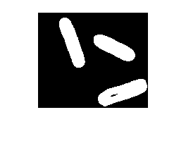
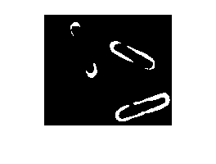
Convert image to gray and determine threshold level
Step 2: Define grayscale image
Step 3: Define mask
im_gray = rgb2gray(im)

Slide 15
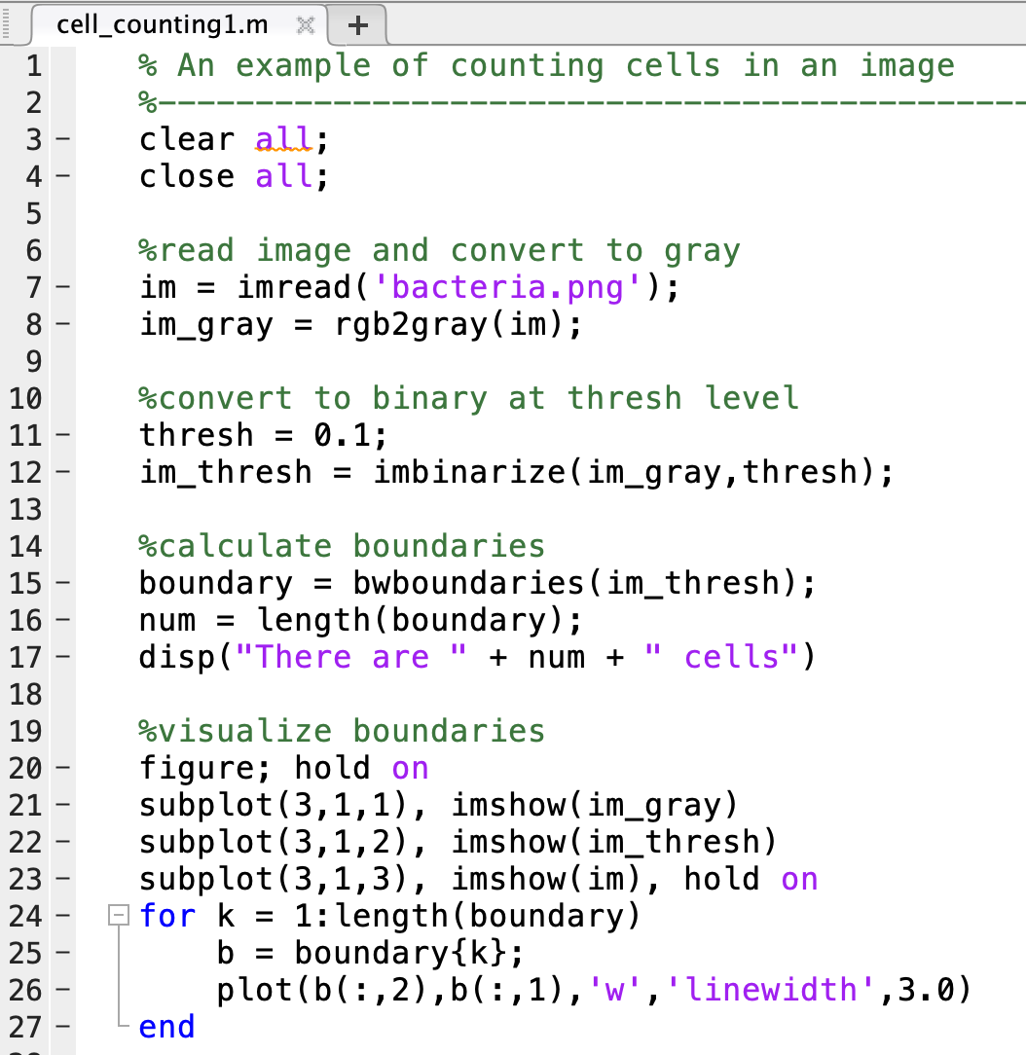
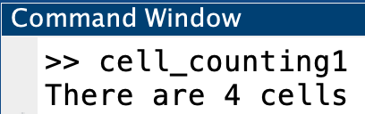
Count # of cells based on good threshold level
Step 4: Analyze objects

Slide 16
Image processing functions: image enhancement
imadjust | Contrast-adjusts intensity values
adapthisteq | Increases brightness

Slide 17
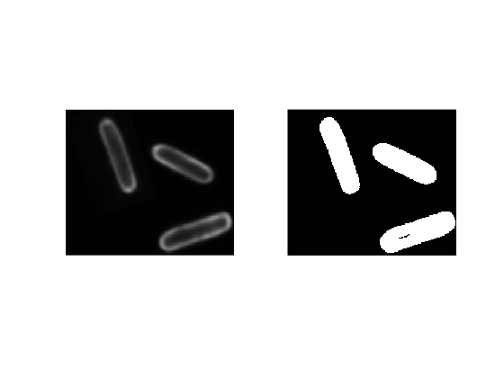
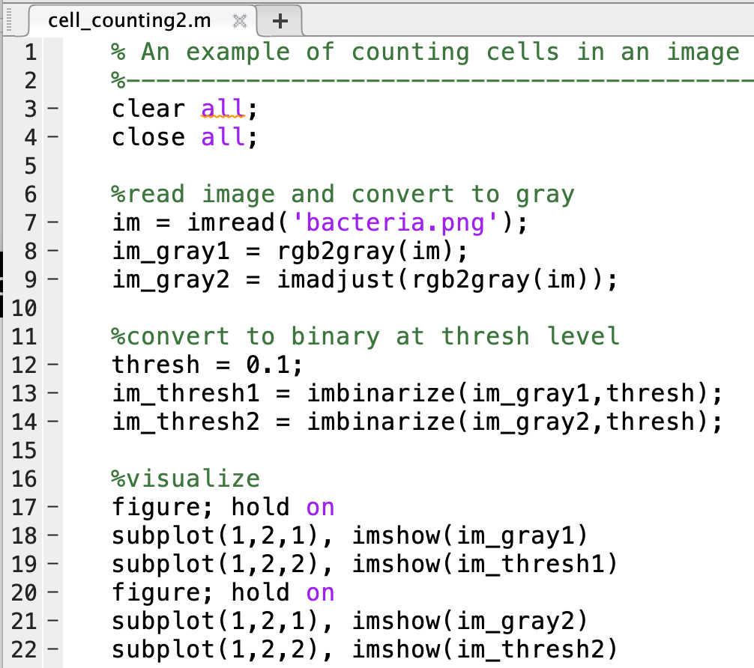
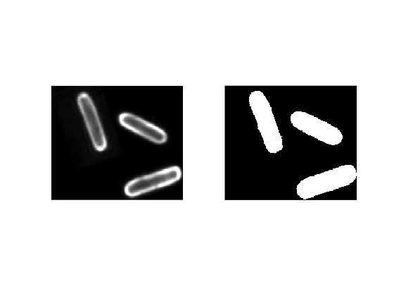
Enhance grayscale image with imadjust
im_gray1
im_gray2

Slide 18
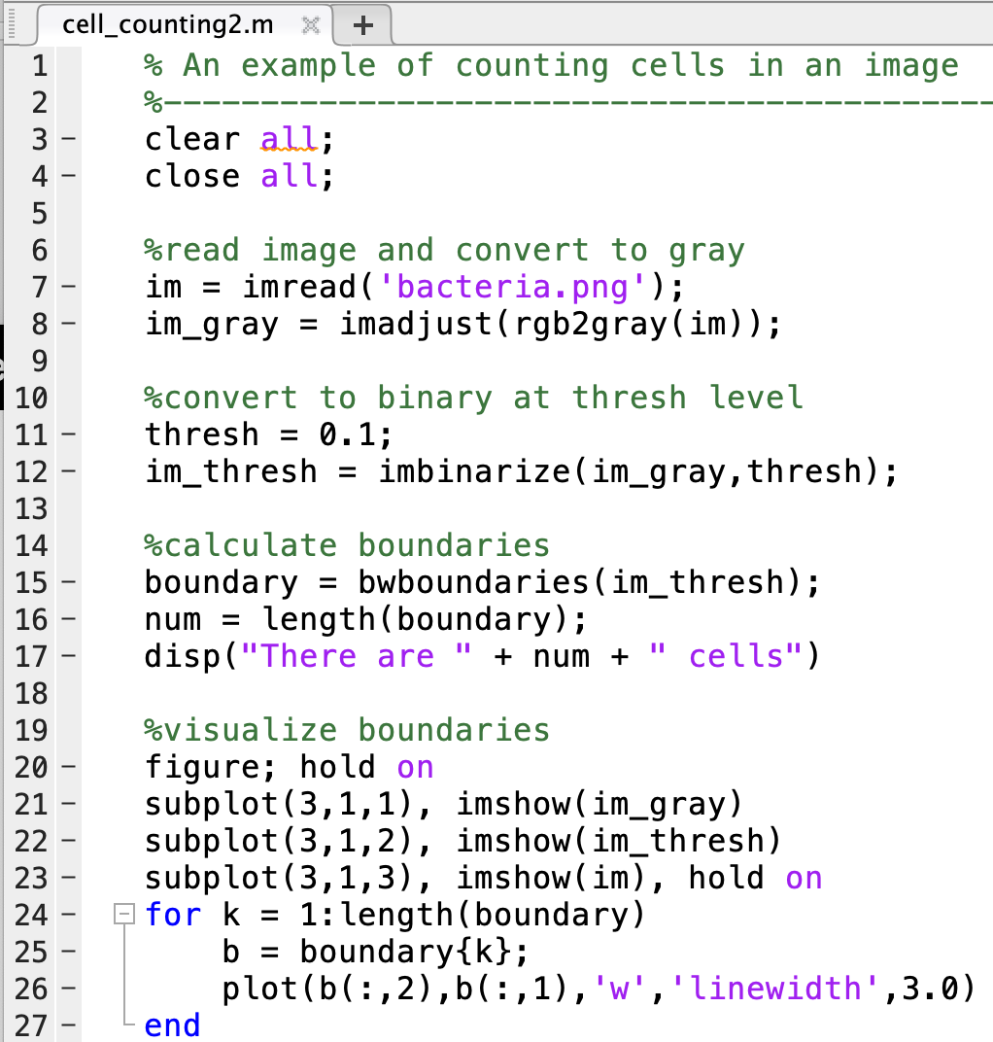
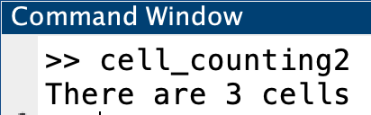
Find the number of objects in this picture:

Slide 19
Algorithm for image thresholding and segmentation
Load the image
Define grayscale image
Adjust the image to optimize exposure for objects of interest
Define mask at specified threshold level
Analyze the objects of interest within the mask (counting, intensities, etc.)

Slide 20
Melanophores from Xenopus were imaged using confocal microscopy (lec9_GrpEx1_xenopus_melanophore.jpg). Cells were stained such that microtubule cytoskeleton are in green, the nucleus is blue, and pigment granules in red. We want to analyze the nucleus.
Generate a 1x3 subplot:
Left: show the original image
Middle: the grayscale image
Right: a grayscale of the blue layer from the RGB image only that is enhanced using imadjust.
Write a for loop to test out 6 different threshold levels for the grayscale blue layer image using linspace(0,1,6). Visualize the mask with imshow in a subplot at every loop.
Choose the threshold level that highlights the nucleus best, and use bwboundaries to calculate the boundary. How many boundaries do we expect, and if we did not get that, what do you think is the problem, and are there methods you can think of to improve the accuracy?
Group example 1: Practice with thresholding

Slide 21
Image processing functions: mask enhancement
imfill | Fill mask gaps
imopen | Open mask gaps
strel(‘disk’,r) | Determining opening and closing pixel size
imdilate | Expand local mask areas
imerode | Reduce local mask areas

Slide 22
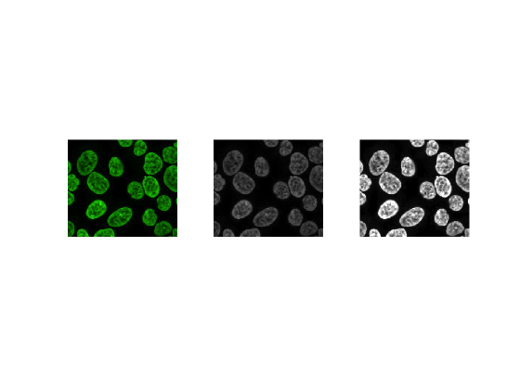
Let’s try again, now a little harder:
Count the number of yeast cells in the image. ‘yeast.png’
24 cells !

Slide 23
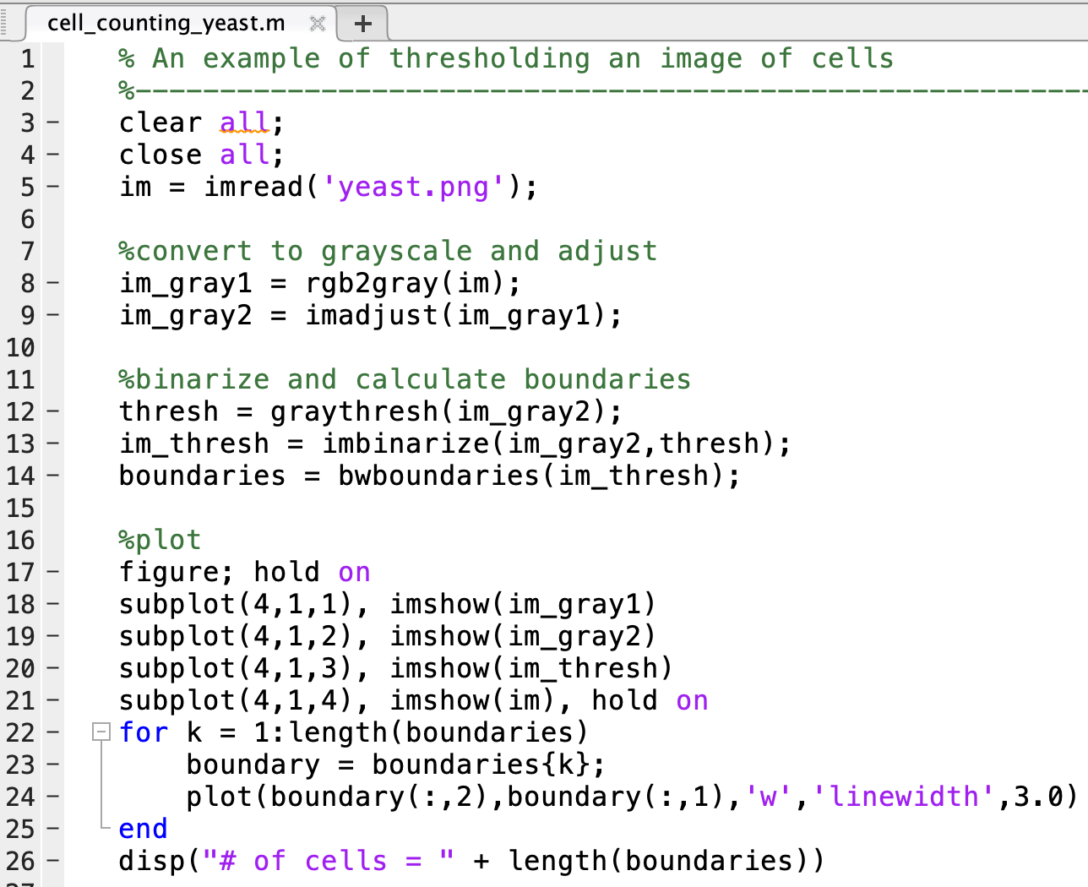
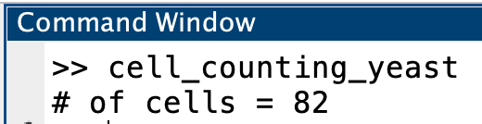
Same pipeline as before doesn’t work. Why?

Slide 24
Improving quality of an image mask: imfill
mask2 = imfill(mask1,’holes’);
Fills image regions and holes that are left open in a binary mask

Slide 25
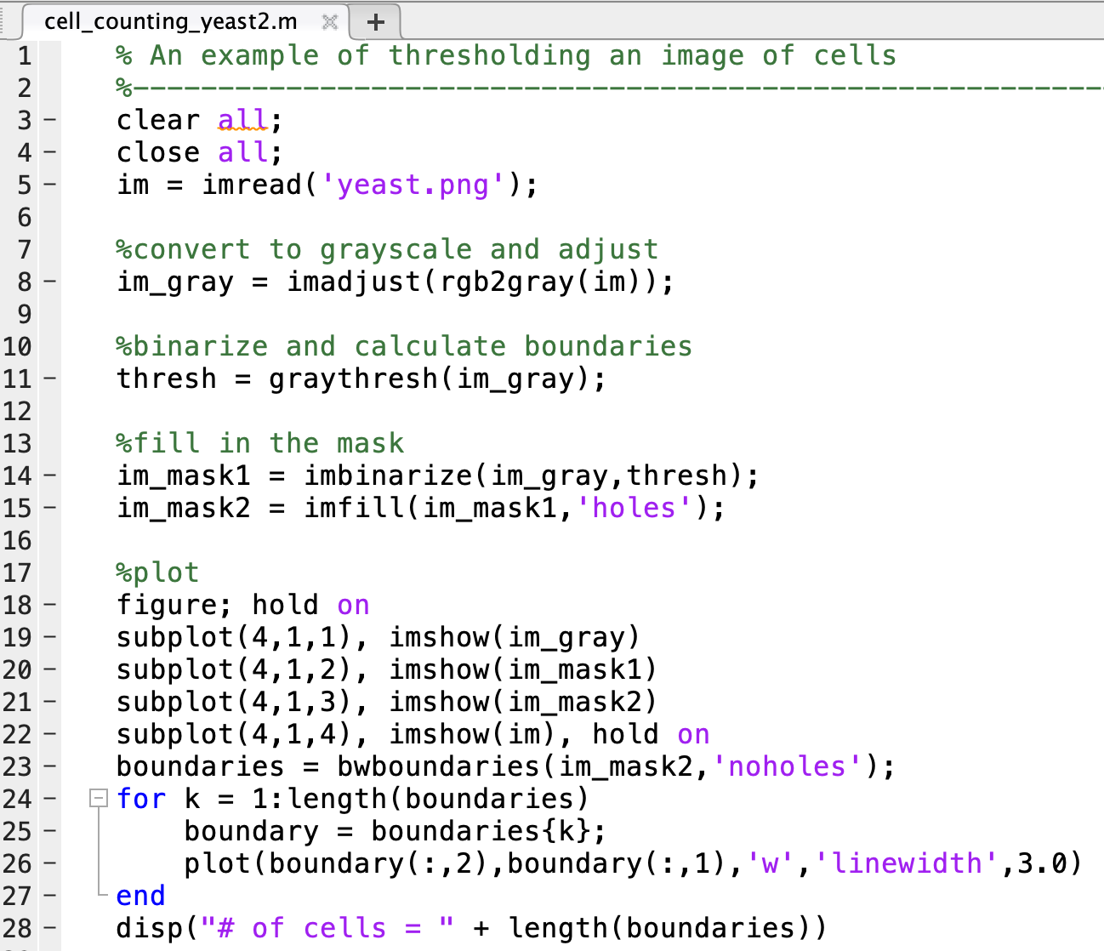
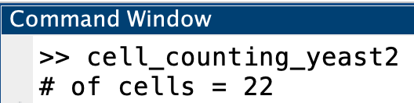
Filling in holes in mask
Mask 1
Mask 2
Better….but still not quite!

Slide 26
Improving quality of an image mask: imerode
mask3 = imerode(im, SE);
Erodes the binary image im at the edges according to the structuring element SE
SE is a morphological structuring element. You can picture this as the tip of an eraser or marker that erodes (here) or dilates (see image functions) boundaries within a mask
We will typically use a circular shape for SE:
SE = strel(‘disk’,r), where r is the radius of the circle (e.g., to erase large segments around the edges of a mask, use large r)

Slide 27
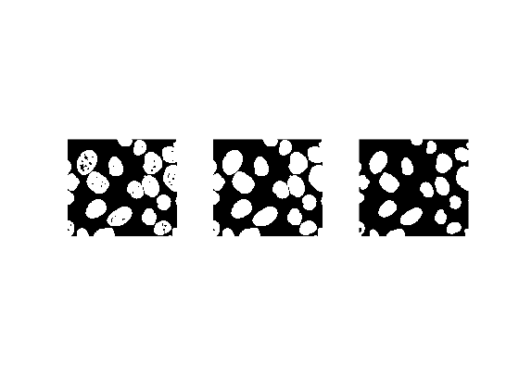
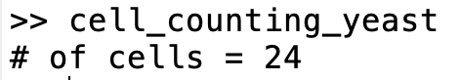
Eroding edges in the mask
im_mask1
im_mask2
im_mask3
im_mask1 = imbinarize(im_gray);
im_mask2 = imfill(im_mask1,'holes’);
im_mask3 = imerode(im_mask2,strel('disk',6));
Approximate number of pixels you want to erode around the edges

Slide 28
Algorithm for image thresholding and segmentation
Load the image
Define grayscale image
Adjust the image to optimize exposure for objects of interest
Define mask at specified threshold level
Adjust the mask to ensure all objects of interest are closed
Analyze the objects of interest using image segmentation:

Slide 29
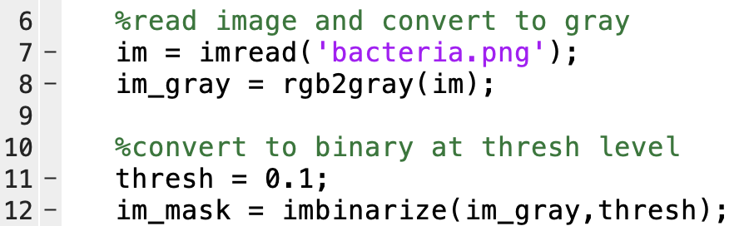
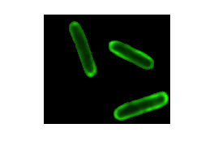
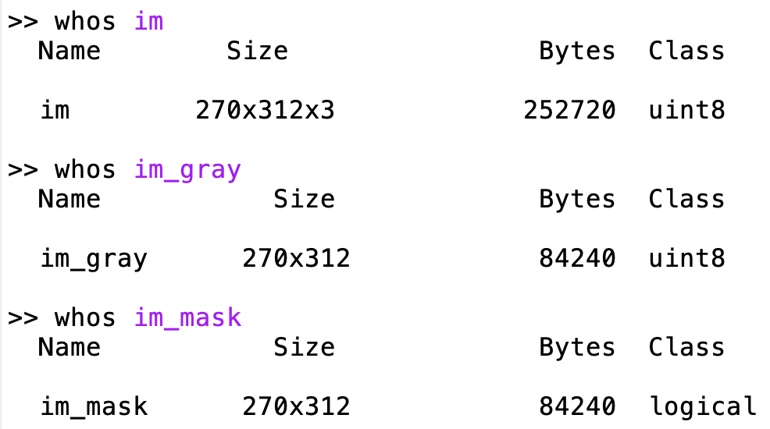
Filtering images with masks
Two reasons to filter an image:
To visualize
To calculate properties within the unmasked region
Pay attention to the variable class – they often change at each step, but must be kept consistent for specific steps:
RGB images should be in uint8
Grayscale images should be in uint8
Masks should be a logical variable class

Slide 30
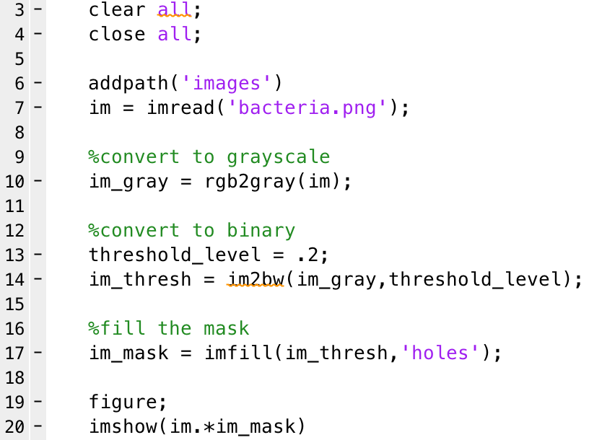
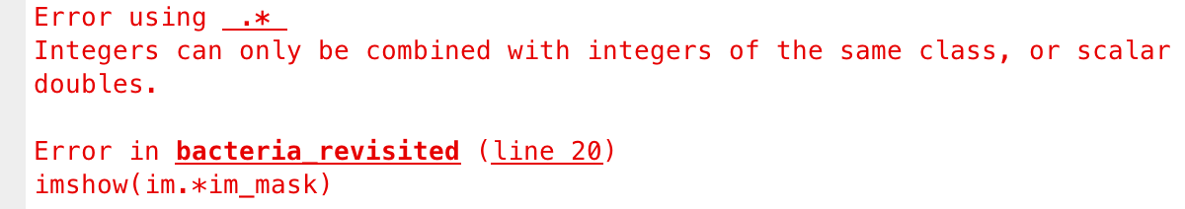
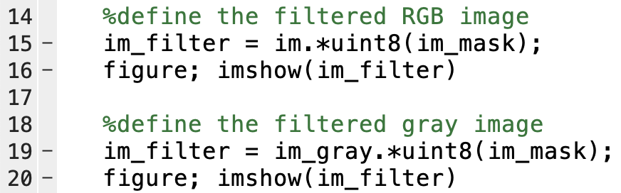
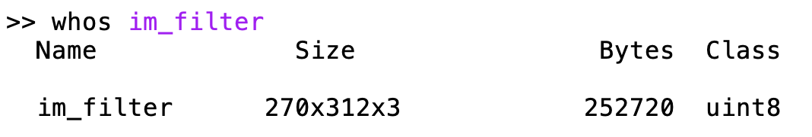
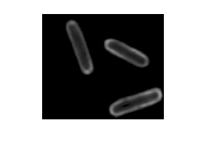
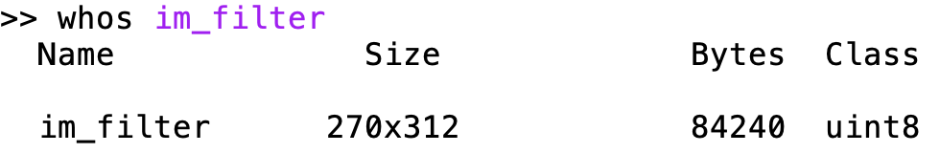
1. Filtering an image to visualize it
You can (and should) filter an image by its mask for visualization purposes to verify your mask is correct
To filter an image for visualization, we multiple the two matrices together:
However, they must be same class!! Convert to uint8:

Slide 31
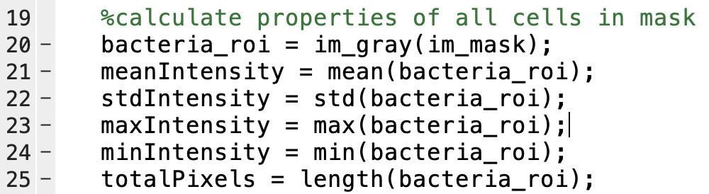
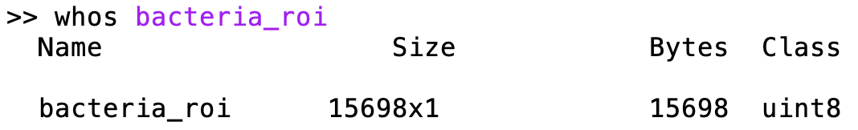
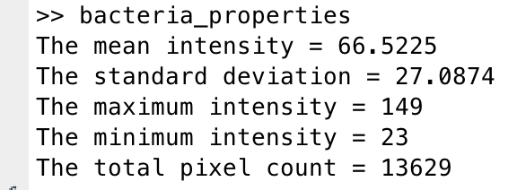
2. Filtering an image to calculate properties of the image
To extract quantities (such as fluorescence intensities, areas i.e. pixel counts, etc.), we use logical indexing
This must be done on the grayscale image since it is an nxm matrix
Common metrics for cell numbers/density:
Mean intensity per area of mask
Mean intensity per # pixels in mask
# pixels in mask per area
….any others?

Slide 32
lec9_GrpEx2_DAPI.jpg contains DAPI stained human tissue cells. Use any combination of the methods we just learned to:
Generate an accurate mask for the image
Draw the boundary around each cell
Count the total number of cells in the image.
Generate a subplot as shown on the right, and report the average fluorescence of all cells in the image
Note: you should be using this as a time to explore the functions described in this ppt
Group example 2: Practice with cell segmentation

